Slide 1
SOFTWARE 2.0
THE FUTURE OF SOFTWARE DEVELOPMENT

Slide 2
PRESENTED BY
M.WALEED AHMED 02-131242-119

Slide 3
WHAT IS SOFTWARE 2.0 ?
Software 2.0 refers to a new paradigm in software development where machine learning (ML) algorithms and neural networks are used to build autonomous systems that can learn from data and improve their operation without human input.
Key Features
Data-Driven Development
Machine learning Algorithms
Neural Networks
Autonomous Systems
Learning and Adaptability

Slide 4
Why is Software 2.0 Important?
POINTS |  | DESCRIPTION
 | Efficiency | Automates complex tasks that are hard to code manually.
 | Scalability | Can handle vast amounts of data and tasks.
 | Innovation | Enables breakthroughs in autonomous systems, and beyond.

Slide 5
Key Differences Between Traditional Software and Software 2.0
Aspect | Traditional Software | Software 2.0
Programming Method | Human-written code | Machine-learned models
Data Role | Secondary | Primary
Development Cycle | Fixed rules | Continuous learning
Adaptability | Limited | Highly adaptive

Slide 6
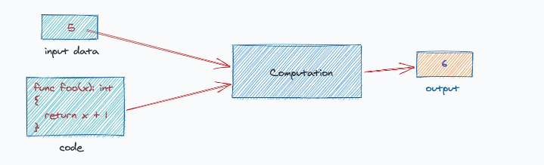

Slide 7
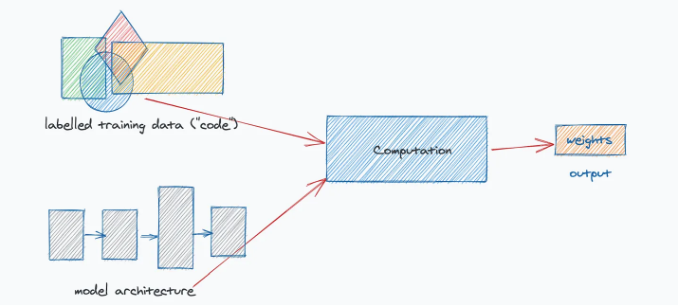

Slide 8
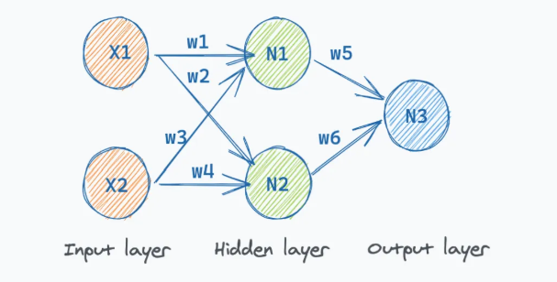

Slide 9
VISION
Prioritizing Learning over Coding
Revolutionizing industries with automation and intelligence.

Slide 10
CORE CONCEPTS AND ARCHITECTURE OF SOFTWARE 2.0
Understanding the Foundation of a Data-Driven Approach…

Slide 11
WHAT IS DATA-DRIVEN PROGRAMMING ?
Data driven programming is a programming model where the data itself controls the flow of the program and not the program logic.
Key Features
Models are trained on data to perform tasks.
Relies heavily on data quality and quantity.

Slide 12
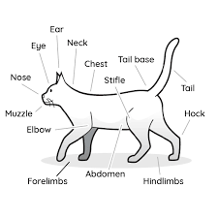
Training Machine Learning Models: The 'Cat or Not a Cat?'
Example

Slide 13
ARCHITECTURE OF SOFTWARE 2.0
This table summarizes the key functionalities of the different layers in the Software 2.0 architecture. Each layer plays a crucial role in the overall system.
LAYER | FUNCTIONALITY | EXAMPLES
Data Layer | Collects and stores data | Cloud storage, databases
Model Layer | Trains and serves models | Deep learning for predictions
Application Layer | User interface for applications | Voice assistants, recommender systems

Slide 14
Role of Machine Learning in Software 2.0
Core Idea:
Machine learning enables the development of models that can:
  Learn patterns from data.
  Make predictions or decisions without explicit programming.

Slide 15
Role of Machine Learning in Software 2.0
Algorithms
Training datasets
Continuous improvement through feedback

Slide 16
DATA LIFECYCLE
This table summarizes the essential processes in managing data within Software 2.0. Each stage plays a pivotal role in ensuring effective machine learning.
PROCESS | DESCRIPTION | IMPORTANCE
Data Collection | Gather diverse datasets | Critical for model training
Data Preprocessing | Clean and format data | Enhances input quality
Data Annotation | Label for supervised learning | Improves model accuracy
16

Slide 17
SOFTWARE 2.0 WORKFLOW
  Model Training: Using ML algorithms to create predictive models.
  Deployment: Integrating models into applications.
Step 2
Step 4
Step 1
Step 3
Step 5
  Data Collection: Gathering large, high-quality datasets.
Validation: Testing models for accuracy and reliability
  Monitoring & Feedback: Continuously updating and improving models.

Slide 18
APPLICATIONS OF SOFTWARE 2.0

Slide 19

APPLICATIONS INCLUDES
HEALTH CARE
FINANCE
AUTONOMOUS VEHICLES

Slide 20
EXAMPLE OF SOFTWARE 2.0 IN HEALTH
Feature | What It Does
Finding Sickness Fast | AI helps doctors quickly find out why someone is sick.
Talking Helpers | Chatbots answer health questions like a friendly doctor.
Robot Nurses | Robots help doctors by carrying medicines or assisting in surgeries.
Helping Scientists | AI helps make new medicines faster and better.
Keeping Hospitals Clean | Robots clean hospitals to keep them free from germs.

Slide 21
EXAMPLE OF SOFTWARE 2.0 IN
AUTONOMOUS VEHICLES
Feature | Example
Self-Driving Cars | Tesla cars drive by themselves on busy roads in the US.
Smart Navigation | Google Maps helps cars find the fastest route to school.
Accident Prevention | AI stops cars if something suddenly crosses the road.
Energy Saving | Electric cars use AI to save battery power.
Robot Delivery Cars | In China, small cars deliver pizza to your home.

Slide 22
EXAMPLE OF SOFTWARE 2.0 IN FINANCES
Feature | Example
Finding Scammers | AI stops bad guys from stealing money online.
Saving Money Tips | AI apps help families plan and save money for toys or trips.
Smart Banking | Some banks let you ask questions to an AI instead of a person.
Quick Loans | AI decides who can get money loans faster.
Shopping Safety | AI protects your card when buying games online.

Slide 23
FAMOUS CASE STUDIES
TESLA NAVIGATION SYSTEM
GOOGLE AI
Uses AI for detecting different diseases with almost high precisions
Uses API for track navigation system , different AI sensors also help during tracking
NETFLIX
NADRA
AI systems verify identity through biometric data
AI recommends shows and movies by analyzing what you like to watch, making entertainment personalized for everyone.

Slide 24
BENEFITS OF USECASE OF SOFTWARE 2.0
Faster and accurate results
Route optimization
Better security and fewer financial losses
Tailored content for better understanding

Slide 25
CHALLENGES IN SOFTWARE 2.0

Slide 26
CHALLENGES IN SOFTWARE 2.0
Ethical Issues:
Bias: AI models may reinforce societal biases. Example: Facial recognition systems criticized for racial inaccuracies.
Privacy: AI requires vast user data, raising concerns over misuse.
Technical Issues:
Dependency on large datasets.
Computational cost and energy consumption.

Slide 27
ADDRESSING CHALLENGES
DIVERSE DATA SET
Reduce biases by including broader demographics.
XAI
Make decisions more transparent and understandable.
ADVANCES IN CLOUD AI
Lower computational costs.

Slide 28
FUTURE DIRECTIONS

Slide 29
FUTURE DIRECTIONS
Advancements:
Real-Time Learning: AI systems adapting instantly to new data (e.g., disaster management in Japan).
Integration: Merging AI with IoT and quantum computing for smarter systems.
Vision for Software 3.0:
Fully Autonomous Systems: Capable of creative and self-driven problem-solving.

Slide 30

FUTURE VISION
Prepare today to lead tomorrow's technological revolution."

Slide 31
Thanks!
"With resilience, harmony, and hope, we can shape a future where technology uplifts humanity."

